Slide 1


A Fatigue Penalty Model for xG

Slide 2
The Fatigue Penalty:
Quantifying the Impact of Workload on Shot Performance in Elite Football
Conor Malone

Slide 3

Who am I?
Conor Malone, a Data Scientist in Dublin, Ireland
Irish Rugby
NFL Big Data Bowl
Wind Energy

Slide 4
Motivation
Every team at nearly every level is collecting physical metrics, can we use them to calculate the performance cost of exertion?
Instead of optimizing metrics to avoid injury can we optimize performance to win more games?
Can we identify a "performance cost" of accumulated workload?
Does fatigue negate the advantage of fielding an elite player?

Slide 5

Performance Before
I first tried to tie performance data to physical metrics 10 years ago in Irish Rugby but back then we were operating from GPS tracker data:
Single Team: We only had our own team metrics
Small Data:Not enough data to generalize/scale
Use:Injury Prevention, Performance Optimization

Slide 6
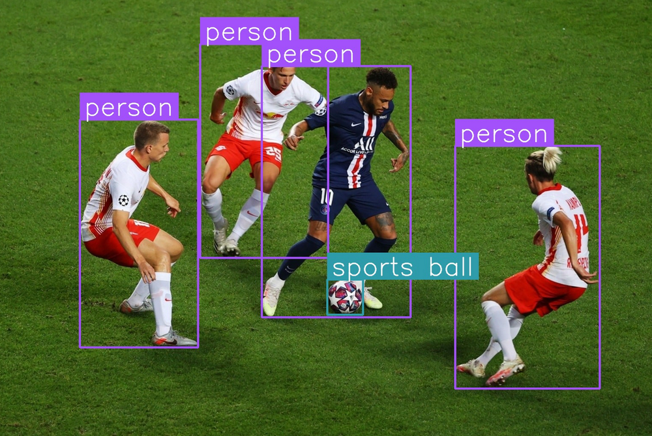

Performance Now
With computer vision physical metrics are available at scale for every team.
Any Team: Data available for potentially any team/game
Big Data: Enough data to build models
Use: Player/Team Evaluation & Recruitment

Slide 7
Dataset I: Event Data
61,000 non-penalty shots
2340 Matches
1618 shooting players
Competition | Country | 23/24 | 24/25
Bundesliga | Germany | ✔ | ✔
Premier League | England | ✔ | ✔
La Liga | Spain |  | ✔

Slide 8
High Intensity Running
Count and Distance for High-Intensity (HI) actions
Count and Distance for High-Speed Running (HSR)
Count and Distance for Sprinting actions
Running Distance (15–20 km/h)
HSR Distance (20–25 km/h)
Sprinting Distance (>25 km/h)
Maximum Speed (km/h)
Accelerations/Decelerations
Count for Medium-Intensity Accelerations and Decelerations
Count for High-Intensity Accelerations and Decelerations
Overall Load
Total Distance covered
Distance per minute (m/min)
Dataset II
Physical Metrics
Aggregated at 15 minute intervals

Slide 9
What is Fatigue?

Slide 10
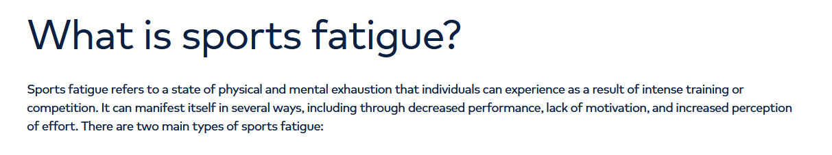

Slide 11
How to Define Fatigue (in a football context)
Elite Footballers are phenomenal athletes, managed to handle immense workload
Does “fatigue” even exist as a measurable performance factor at the highest level?
Notes:
Players regularly run 10+km at high speeds over 90 minutes
They have done this full time since they were children
There are teams of trainers employed to ensure they can do this.

Slide 12
Quantifying Workload
Football, a running sport
Inspired by High Metabolic Load Distance
Normalised (all variables between 0-1)
Single, comparable workload score for each player

Slide 13
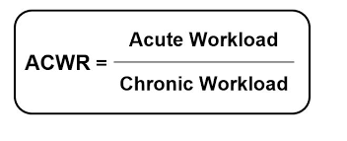
From Workload to Fatigue: The ACWR
Acute:Chronic Workload Ratio
Recommended by IOC in monitoring training loads
Acute Workload: The last 7 days
Chronic Workload: The Average workload in a 7 day period over the last 28 days.
Fatigue = acute workload/chronic workload
ACWR > 1.5 High Injury/Performance Risk
Calculated for every player & team for every match

Slide 14
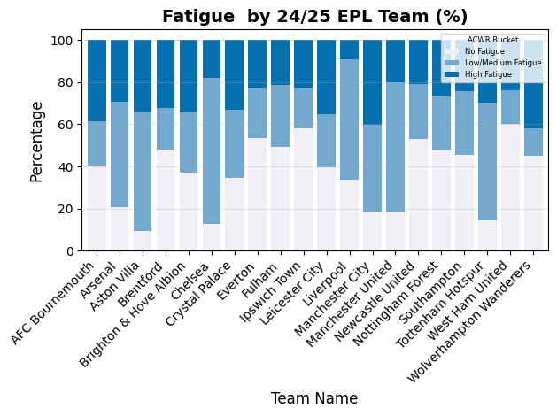
What can ACWR tell us?
Most teams manage fatigue
Team dependent

Slide 15
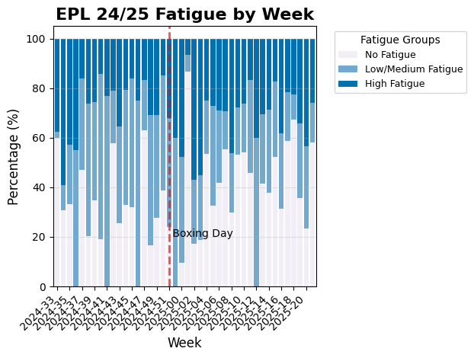

Slide 16
Does Fatigue Effect Performance?

Slide 17
Results
Shot Volume (Team Level)
1 unit of ACWR = -1 shot per game
Significant (p < 0.05) but weak relationship (R² = 0.12)
Shot Quality (xG)
Team Level:
1 unit of ACWR = -0.001 xG per shot
Not Significant (p = 0.1) and weak relationship
(R² = 0.007)
Shooter Level:
No link.
Shot Conversion
No Link

Slide 18
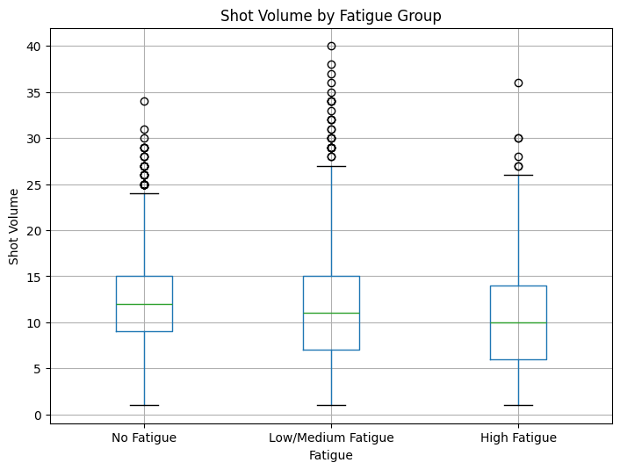
Slide Title (don’t move)
Results show a minor link between team fatigue and Shot Volume.
Significant (p<0.05) but minor negative relationship (R2 = 0.12)
Average reduction of 1 shot per game in move from No to Low to High fatigue

Slide 19
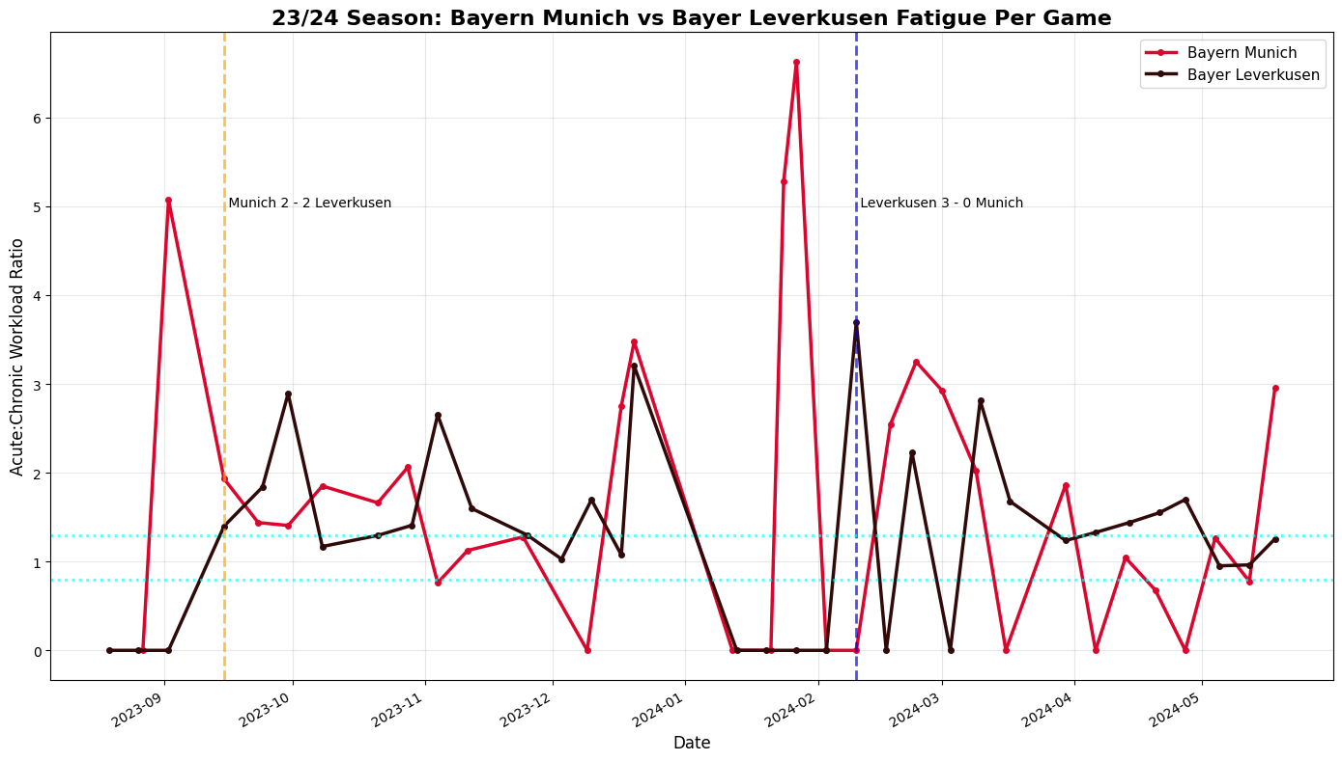
If using video:
Embed these into your slides.
Avoid links to playing online.

Slide 20
Context & Limitations
Match data only: no training
Substitutions limit impact of fatigue
Physical metrics are influenced by tactics and context
Limited to elite football.
Does not capture the mental element of fatigue
Estimated data for some matches
Scope is limited to league matches, excluding high-fatigue scenarios like extra time

Slide 21
Conclusions & Future Work
The “Fatigue Penalty” on shooting in elite football is minimal
Fatigue has only a minor detectable impact on shot volume and quality at elite level
Effect is tactical rather than technical.
Team-level workload associations stronger than shooter-level effects
Workload management practices likely mitigate most observable fatigue impacts
Fatigue link with chance creation metrics?

Slide 22
Thank you.
@conorbmalone.bsky.social

